Slide 1
Geo location analytics ideas
july 2017
PLATFORM ANALYTICS

Slide 2
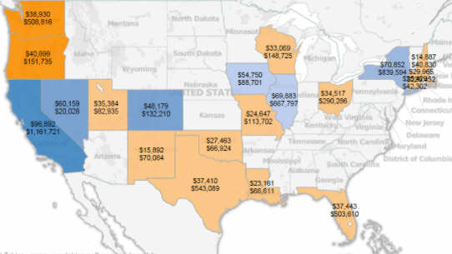
Geo-location Analytics : State-wise
Ideas can be implemented over dashboard
Reporting of main business metrics
Sales Volume
Ticket Size of transactions
Activation Rate
Reactivation Rate
Discount percentages
Top trending products
Details of specific counties with exceptional sales
Predictive model across geographies
Critical markets and their trends by forecasting
Build analytical models to stop negative trends
Run region specific campaigns
Understand the brand loyalties across geographies
Graphs are only for example, numbers are directional

Slide 3
Geo-location Analytics : Major markets
Ideas can be implemented over dashboard
Reporting of main business metrics
Sales Volume
Ticket Size of Txn
Activation Rate
Reactivation Rate
Discount percentages
Top trending products
Specific marketing campaign performance
Graphs are only for example, numbers are directional

Slide 4
Thank you

